Slide 1



ECS200-Software Engineering and project
Occupation
Advertising
System

Slide 2

Team Members(Group B)
NAME | INDEX NO
Ashika Mendis | AA1373
Tanuli Deunuwara | AA1475
Ahamed thowfeek | AA1505
Vishal Ranaweera | AA1494
Dinithi Dilshani | AA1312
Raviprabha Rathnayake | AA1359
Osanda Weerasinghe | AA1431
Yohan Lakshitha | AA1400
Vishwachapa Hewawasam | AA1493
H.M.B.D.H.Hanwella | AA1609

Slide 3
Content
01) Introduction and Background
02) Architecture and solution
03) Demonstration
04)Q & A

Slide 4

Introduction
Today, most people are getting more qualified and employment industry is extremely competitive. So, they must find job vacancies and internships by grabbing newspapers and paper advertisements. It is more complicated because they must look into every notice and find the relevant job fields.
We develop this software to find internships and employers can advertise what are the vacancies that they are offering .
AL tutors can advertise about call programs and Students can find more details of supportive class
The main purpose of this project is to reduce the weight of finding a job vacancies .

Slide 5



Background
Developed using
Java
SQL language
NetBeans IDE
XAMPP
Users
Admin
Company
Undergraduates
Tutors
Sections of the software
Software Details
Hardware Details
Admins
Undergraduate
Job vacancy posts
Issues

Slide 6




Architecture and Solution
This system use three main groups
Tutors
Advertise supportive Classes and courses
Share tutorial structures
Employer
Organizations
Advertise job vacancies and internships
Accept vacancy responses
Undergraduates
Find relative internships and job vacancies
Request relevant vacancies
Submit CVs
A/L Students
Find supportive tutorial classes

Slide 7
Employee Organization
Advertise supportive Classes and courses
Tutors
Database
Share tutorial structures
Advertise Vacancies
System
Accept Responses
Request Vacancies
Find supportive tutorial classes
Find internships and jobs
Undergraduates
A/L students
Login
Power System
Mechatronics
Telecommunication

Slide 8
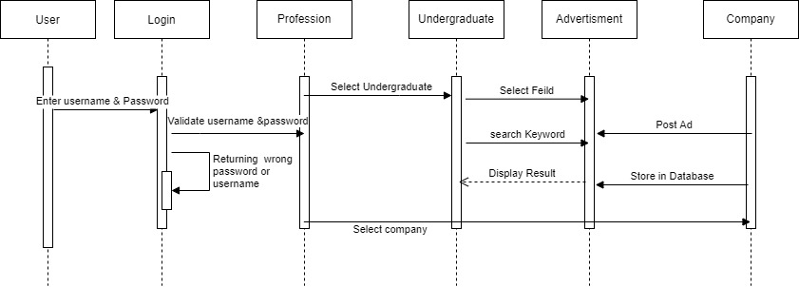
Sequence Diagram

Slide 9
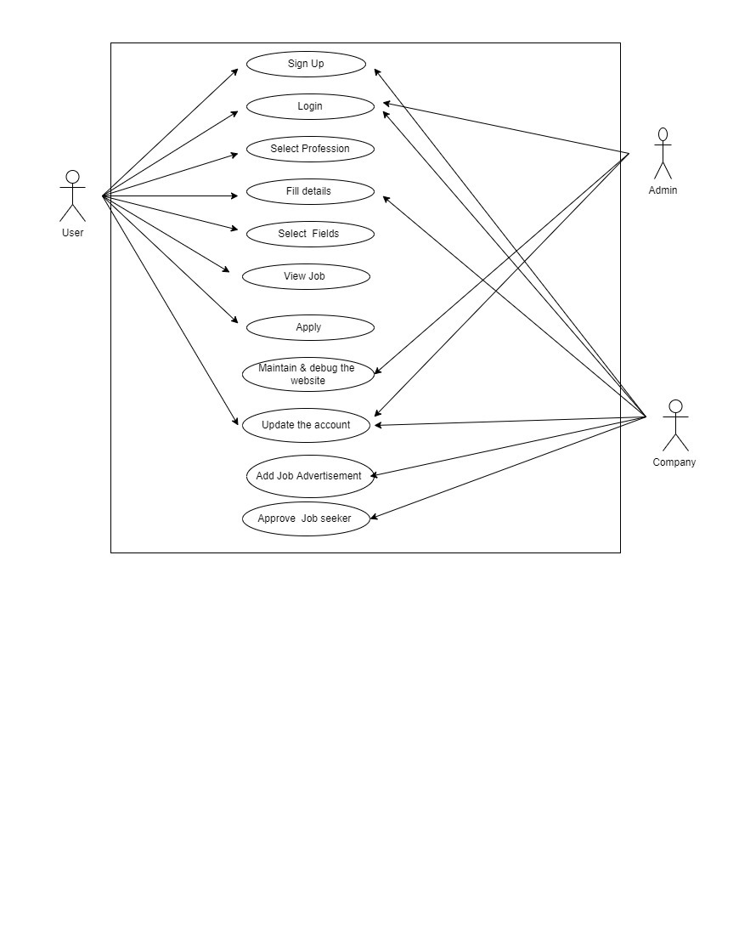
Use Case Diagram

Slide 10
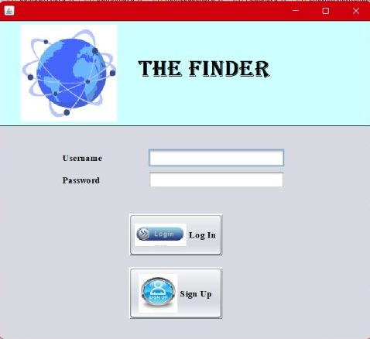
DEMONSTRATION
First Interface
(Login or sign up)

Slide 11
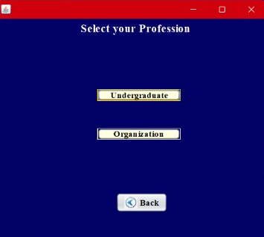
Second Interface
(Select the profession :
Undergraduate or Organization)

Slide 12
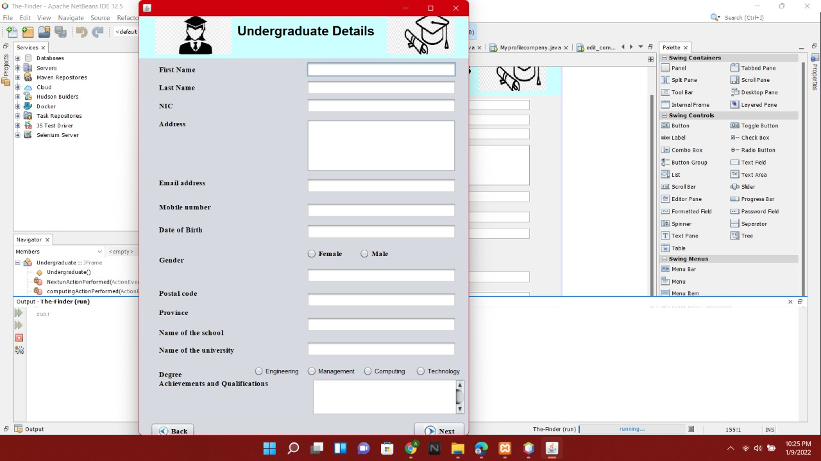
Third Interface
(Undergraduates can fill these details to Login)

Slide 13
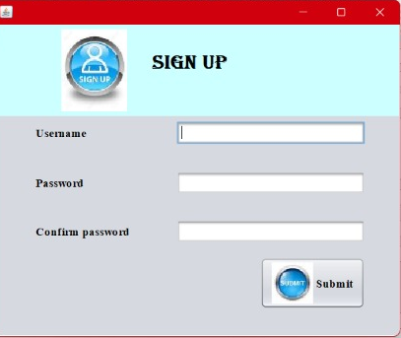
Fourth Interface
(Sign Up with Password)

Slide 14
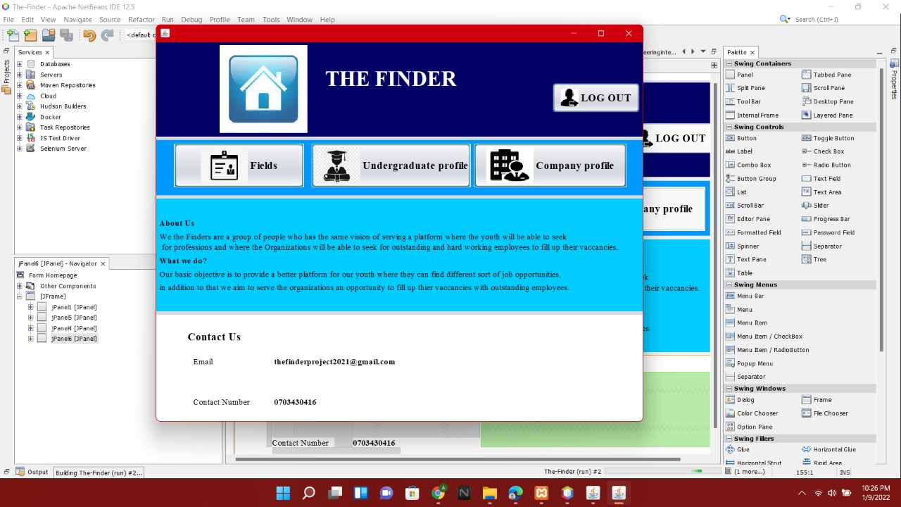
Fifth Interface
(Home Page)

Slide 15
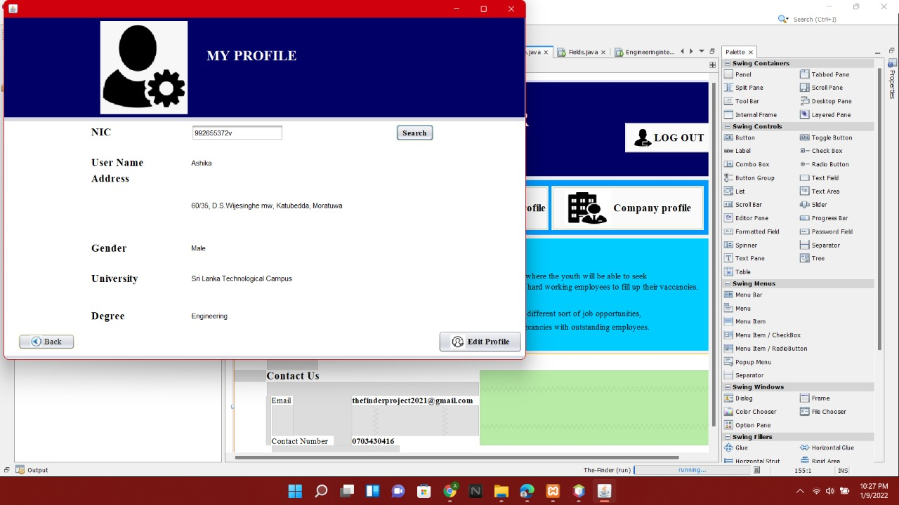
Sixth Interface
(Undergraduate Profile)

Slide 16
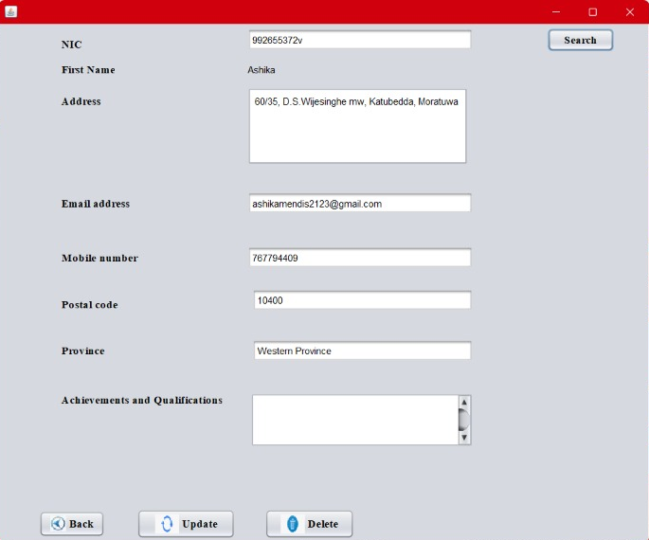
Seventh Interface
(Update Details)

Slide 17
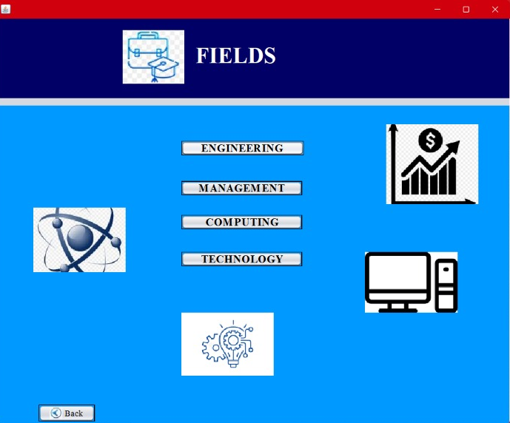
Eighth
Interface
(Select the relevant job field)

Slide 18
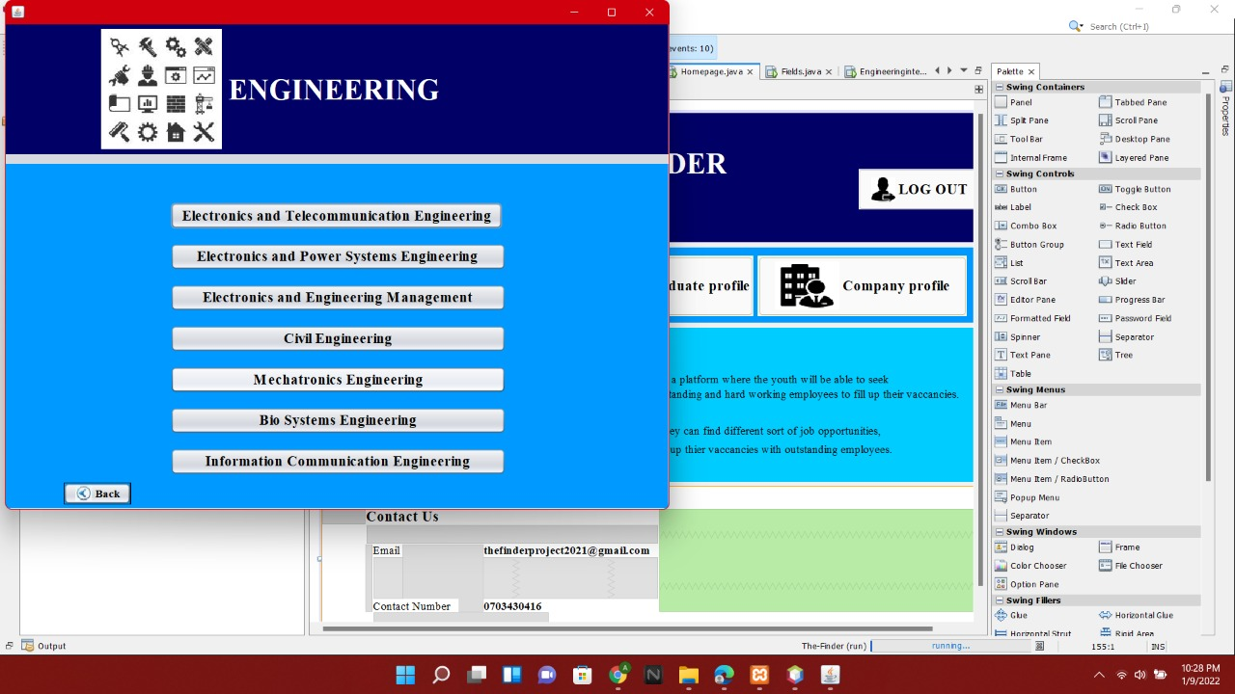
Nineth Interface
(Under each field has several sub fields)

Slide 19
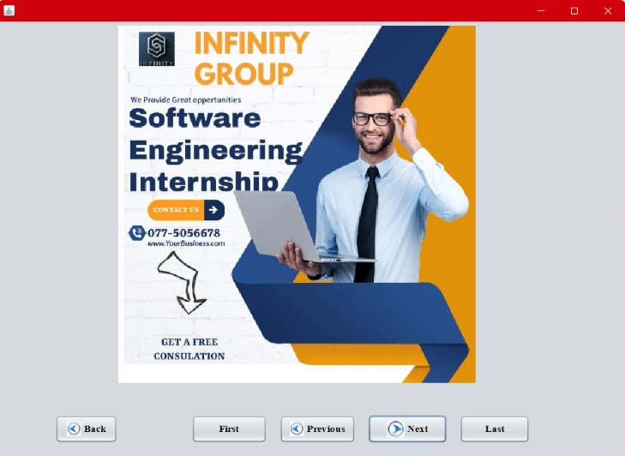
Tenth Interface
(Job advertisements and Posts)

Slide 20
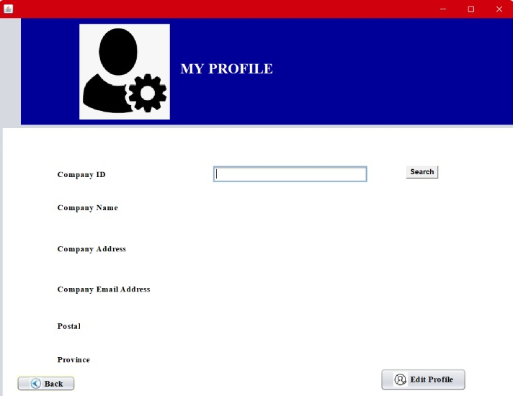
Eleventh Interface
(Company Profile)

Slide 21
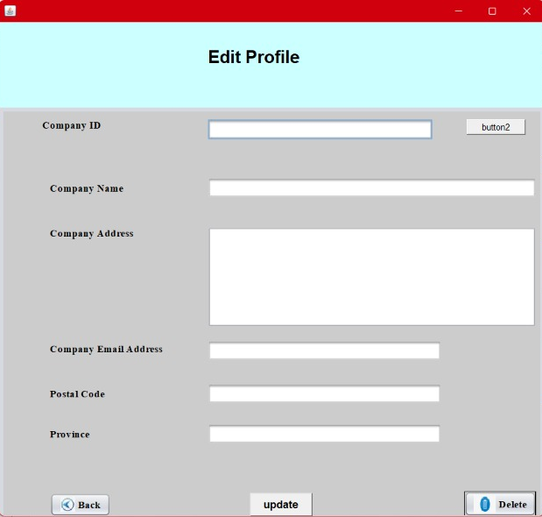
Twelfth Interface
(Edit Company Profile)

Slide 22
Demonstrate Further……
develop the portal to post and share job advertisements
01
Develop the system to submit CVs
02
Contact and accept job seekers CVs by companies.
03
Build another portal for A/L students and Tutors
04

Slide 23

Difficulties Arisen
Collect all the necessary required information such as applicant details and organization details.
Implementing the system according to the coding standards.
Lack of knowledge and Hard adaptability for programming languages.
Finding organizations with job vacancies.
Designing a simple and clear user-friendly interface.
Completing the project within the given deadline.
Due to pandemic situation there were many communication issues

Slide 24

Q & A
THANK YOU !

